Slide 1
UCLA CS97 Discussion 1B/1C
Week 7

Slide 2
Announcements
Assignment 4 due yesterday (Feb 18)
Assignment 5 due next Wednesday (Feb 24)
Midterm Grades coming soon

Slide 3
Quick Overview of C

Slide 4
What is C
C without the plusses!
C++ was created to be C with extra features
C was created in 1972 at Bell Labs by Dennis Ritchie (Ken Thompson also helped)
The development of C is closely tied to the development of Unix as an OS
Started as a new systems programming language B, but was improved and renamed C
Multiple versions since then
C89 was the first C standardized for any ANSI system
C99 is pretty common to work with too (Mostly C89 with added features. Like declaring variables in the for loop! And // comments)
What is C useful for?

Slide 5
C vs C++
So what did original C have?
Still manual memory management
Still a compiled language
Same basic data types (int, float, double, char, etc)
What is missing that you are used to from C++?
Classes – C is procedural and NOT object-oriented
Standard Template Library (STL)
Exceptions
String objects – C uses char arrays or C-Strings
Stream operators like cin, cout, <<, >>
No bool – False is 0 and True is anything else
Good place for syntax and tutorials
https://www.programiz.com/c-programming

Slide 6
Structs
Structs are the closest things we have to a class in C.
Note – we can only pack variables in a struct. No methods

Slide 7
Usage of structs vs classes
In C++ you think of
You have an object, which has a method to do something for that object
myObject.someMethod()
In C you think of
You have a function which can do something given some parameters
myFunction(&myStruct)

Slide 8
Pointers
Same as C++
You can even have pointers to functions!

Slide 9
Pointers
NOTE – you can’t pass by reference in C. So you need to pass by Pointer.

Slide 10
Passing function as arguments
Just like in languages like JavaScript, or Python, we can bind variables to functions. We just need to use function pointers.

Slide 11
More useful example of a function pointer

Slide 12
File I/O in C
Comes from <stdio.h>

Slide 13
File Pointers
C uses File Pointers to access files in various modes
r for reading, w for writing, a for append
More options for more features
Note reserved file descriptors – stdin, stdout, stderr

Slide 14
I/O in C - printf
Most typical way to print characters/strings to stdout
Use format specifiers to print variables passed as arguments
%d for int, %s for string, %c for chars, etc
https://www.tutorialspoint.com/c_standard_library/c_function_printf.htm

Slide 15
I/O in C – getchar/putchar
Read/Write a single character from stdin/stdout

Slide 16
Dynamic Memory in C
Note – comes from <stdlib.h>

Slide 17
Dynamic Memory
We create a memory block on the heap of a specified size
Typically used for arrays (can also be strings in C) where we don’t know the size of the array until runtime
Like creating a user-chosen size Connect-4 board
3 functions to be aware of
malloc() – allocates memory, is like new in C++
free() – deallocates memory, is like delete in C++
realloc() – reallocates previous block to a new size

Slide 18
malloc
void *malloc(size_t size);
malloc is a function used to dynamically allocate memory in the number of bytes specified, and returns an address to that chunk.
Notice sizeof(int) in example above, malloc needs to allocate the number of bytes required for 10 ints. An int is not a single byte

Slide 19
free
Deallocates memory created by malloc
If you forget to free – you get memory leaks

Slide 20
realloc
Change size of previously allocated memory
Move C-String from size 10 array to size 100
Memory address may be different, but the contents are preserved

Slide 21
Common Dynamic Memory Issues
Using Before Writing
Malloc’d memory contents initialize to garbage, you need to write to it before you can try to use it.
Forgetting to free
Causes memory leak
Double free (freeing the same address twice)
Causes undefined behavior and maybe a seg-fault
Using after free (dangling pointer)
causes undefined behavior
Reading/Writing past the sizes of your array
causes undefined behavior
NOTE – Dynamic Memory issues typically troubleshot with Valgrind

Slide 22
System Calls
Comes from <unistd.h> library

Slide 23
What is a System Call
When user programs need the kernel to perform a privileged operation, they request that via a systems call.
What are common privileged operations?
Process Control – need to alter process execution of a running program
File management – create/delete/read/write to files
Device Management – manipulate peripherals
Information Management – retrieve information from OS like time/date
Communication – Create interprocess communication channels
It is expensive (in terms of performance) to execute these privileged operations.
Requires computer to switch between User and Kernel mode to execute these

Slide 24
System Call vs Library Call
We typically use library calls, like putchar or printf. How do they perform privileged operations like printing to the screen?
They make System Calls!
Note these library calls are typically more efficient than if we wrote our own versions, since they minimize the number of system calls made
Remember, privilege switch is expensive
Library calls also abstract the process of making system calls, making them portable across systems
The system calls in unistd.h only work for POSIX systems. (Not Windows)

Slide 25
System Calls – read/write
#include <unistd.h>
//write n number of bytes from files described by fd to buffer
ssize_t write(int fd, void* buffer, size_t n)
What is a fd?
fd stands for file descriptor. It is an integer which represents an open file handle
STDIN, STDOUT, STDERR are already open for you at the start of your program on 0, 1, 2 respectively
What is a buffer?
Typically, some kind of array

Slide 26
Example syscall – write

Slide 27
Compiling in C

Slide 28
General Overview
Very similar compilation process between C and C++ (preprocess, convert to assembly code, convert to binary object file, link objects together into executable binary)
Instead of g++, use gcc
Example:
gcc –g –Wall –std=c99 source.c –o outputExec
-Wall -> Display compiler warnings
-g -> Make the program debuggable with gdb/valgrind
-std=c99 -> use C99 Standard
-o -> specify output file name

Slide 29
Compiling with Multiple Files
More complex applications require multiple files to be compiled
Example: “Car” Program written in C++
Car.cpp (#include car.h, engine.h, sensor.h, navigation.h)
Navigation.cpp (#include navigation.h, sensor.h)
Engine.cpp (#include engine.h)
Sensor.cpp (#include sensor.h)
How can we compile them together?
g++ car.cpp navigation.cpp engine.cpp sensor.cpp -o car
What happens if we update a single file’s source code?

Slide 30
Quick Intro to Makefile
A makefile is a build tool for C/C++
Allows you to specify compiler targets/commands and dependencies. Will then build objects as necessary and compiles only what is needed based on which files have been updated.

Slide 31
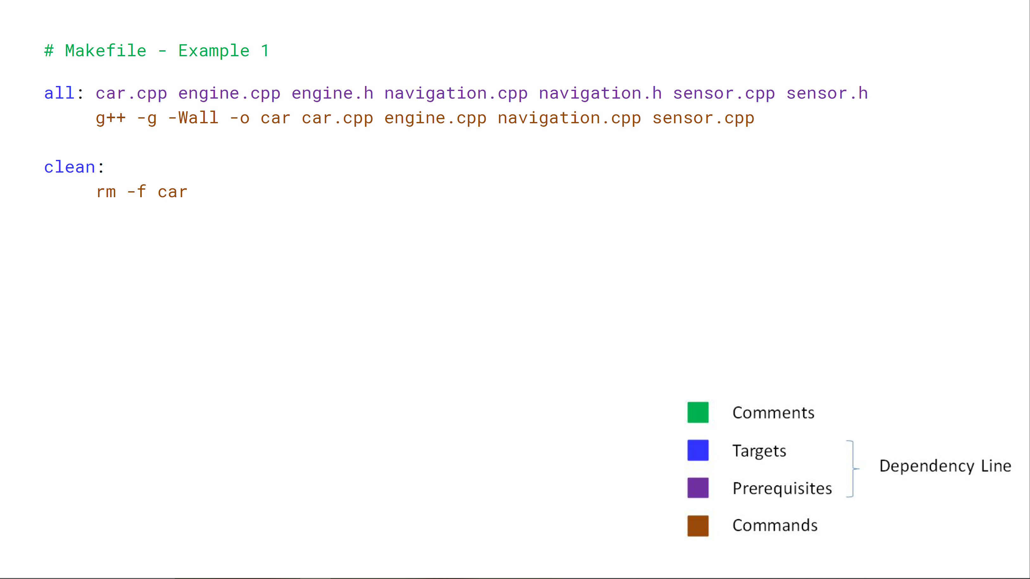
Makefile – Example 1

Slide 32
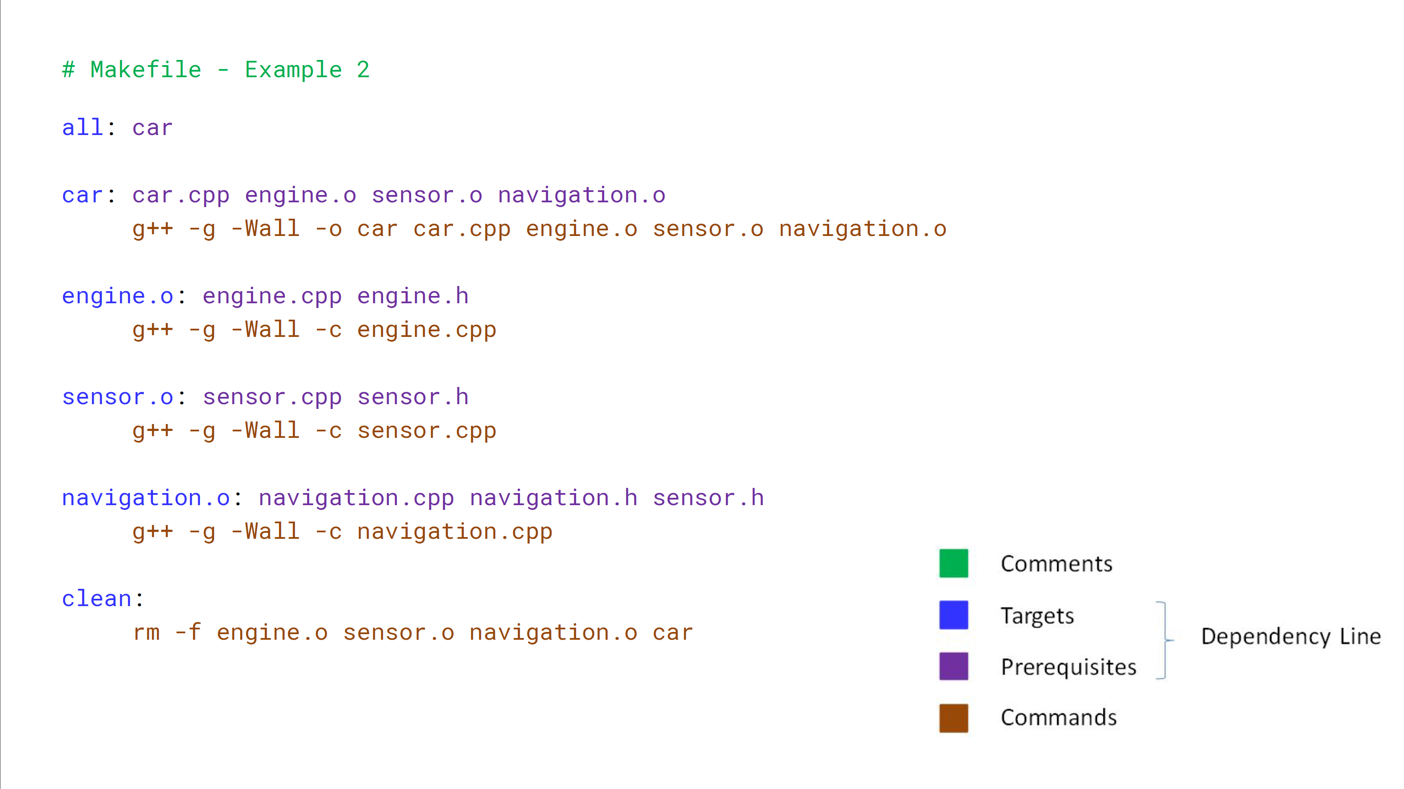

Slide 33
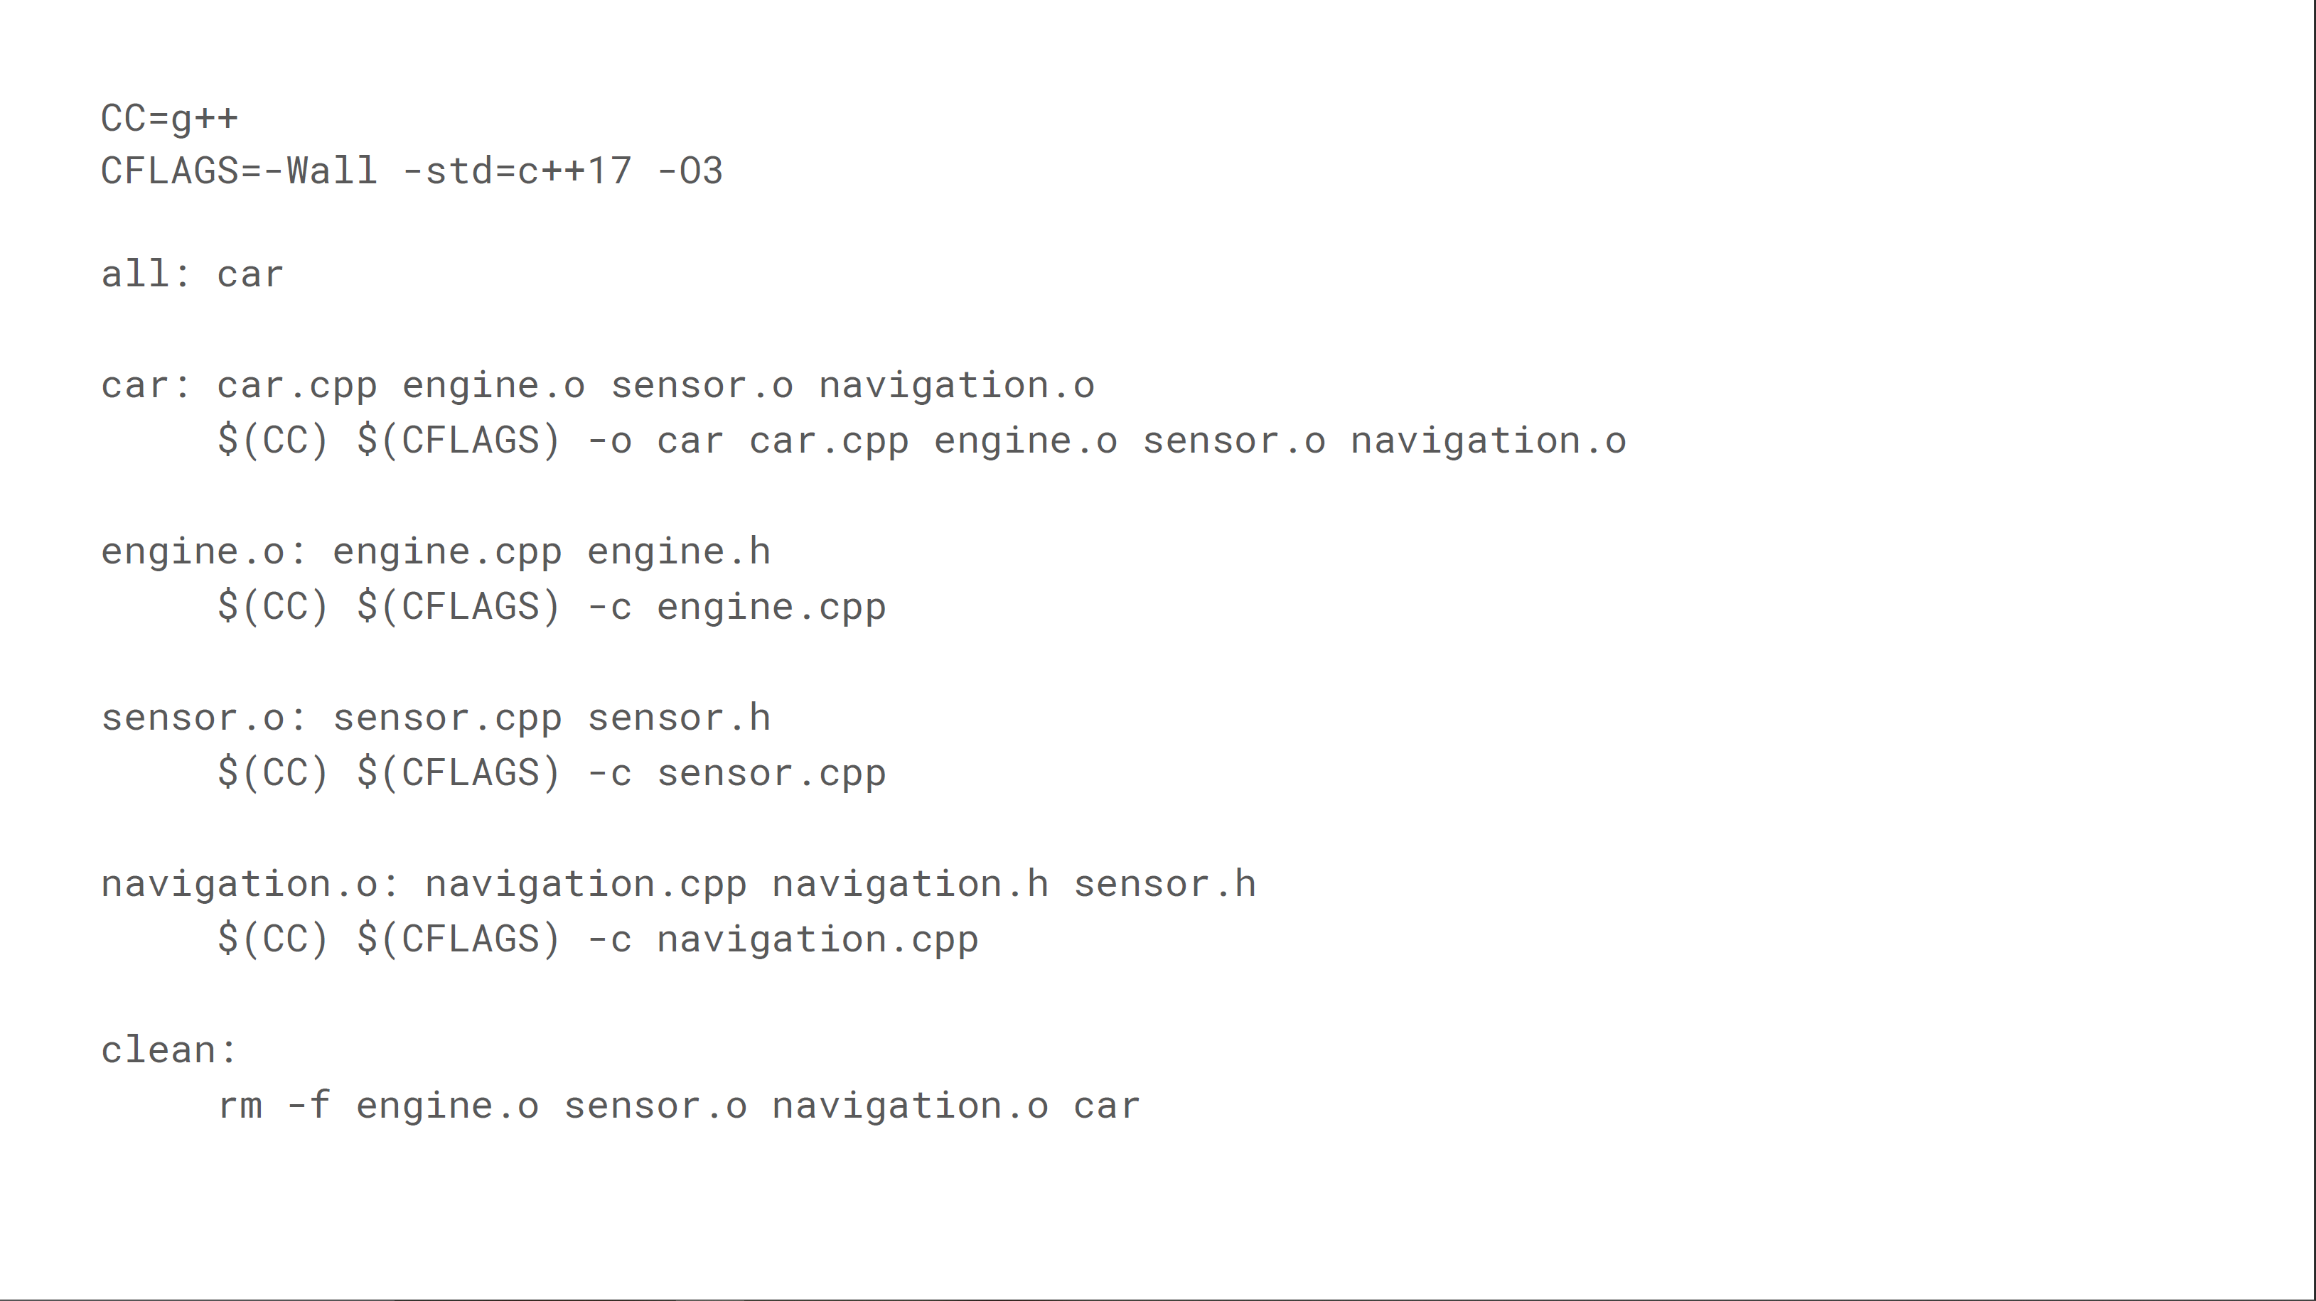

Slide 34
Standard Make commands
When you have a file named just “makefile” then you can access it via Shell commands
Make – compile the default target
Make all – should compile everything
Make install – should install things in the right place
Make clean – should clean things up
Make [target] – call commands for just that group

